Slide 1
T20 world cup 2022 Power BI Report

Slide 2
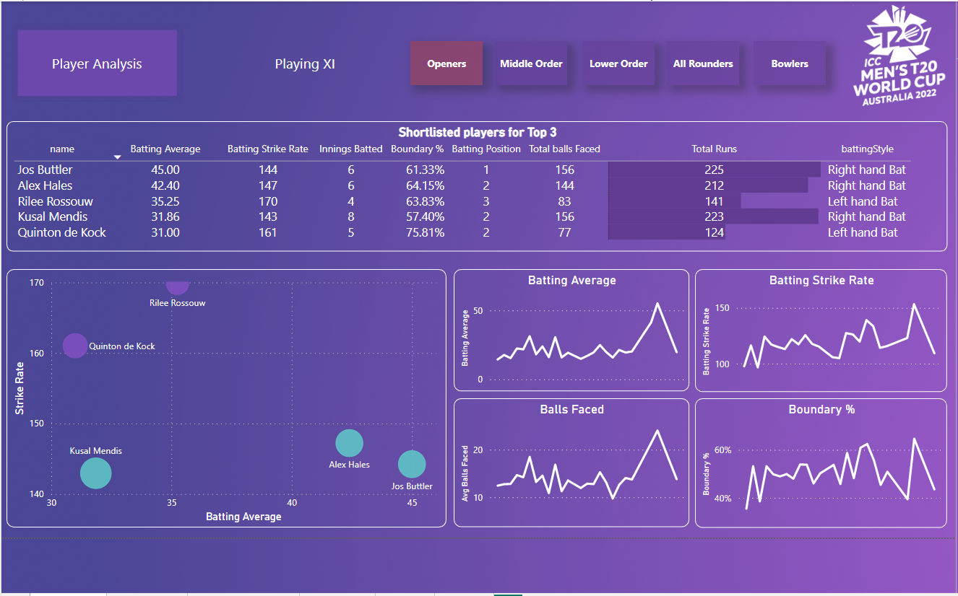
Initial impressions and player category
First page contains the player analysis by different roles.

Slide 3
Player roles navigation
Roles Navigation

Slide 4
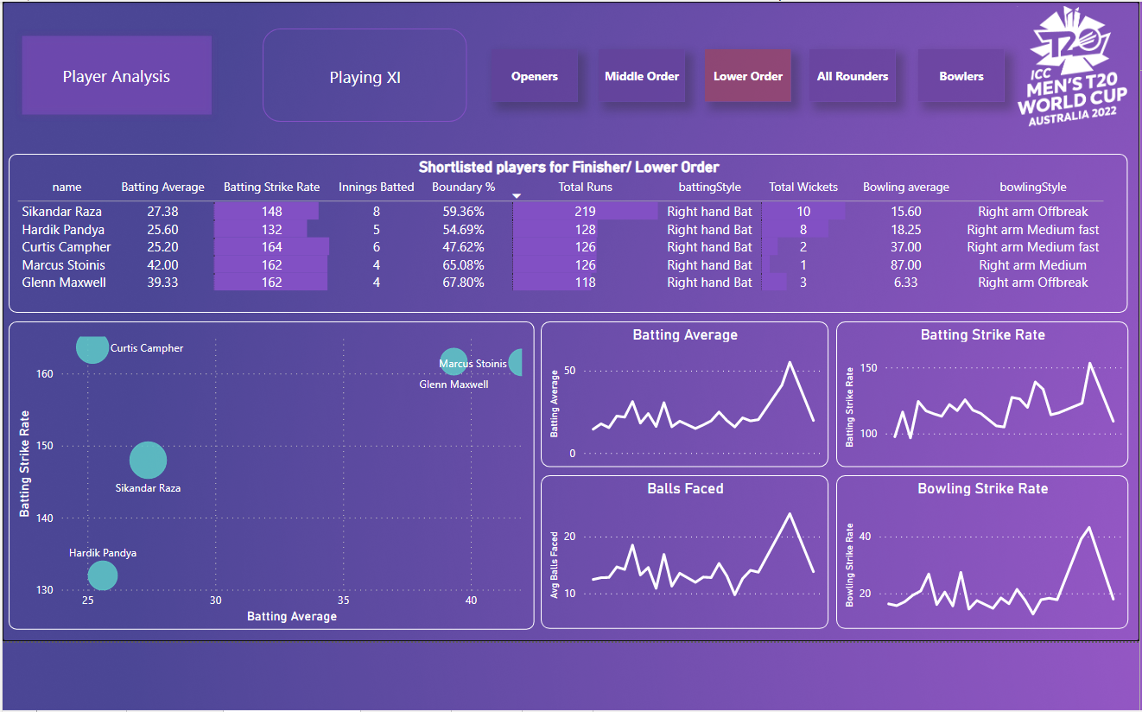
Selection of Various Roles
Shortlisted players statistics
on basis of different graphs.
Selection of lower order players.

Slide 5
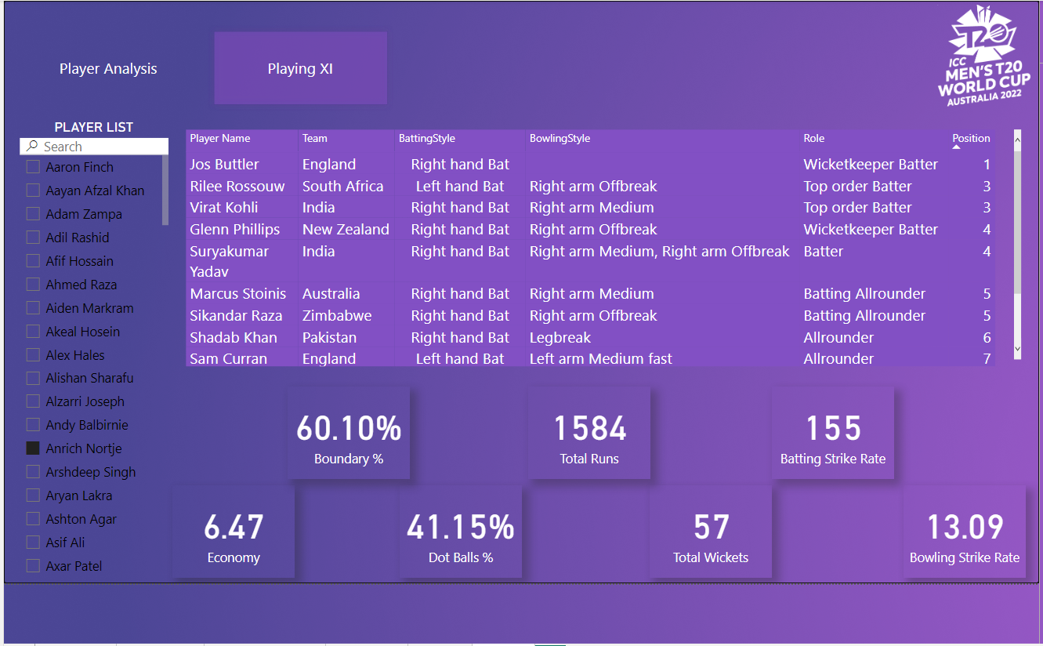
Selection of best possible XI one the basis of shortlisted players having different roles.
cards contains the combined numbers of the selected players.

Slide 6
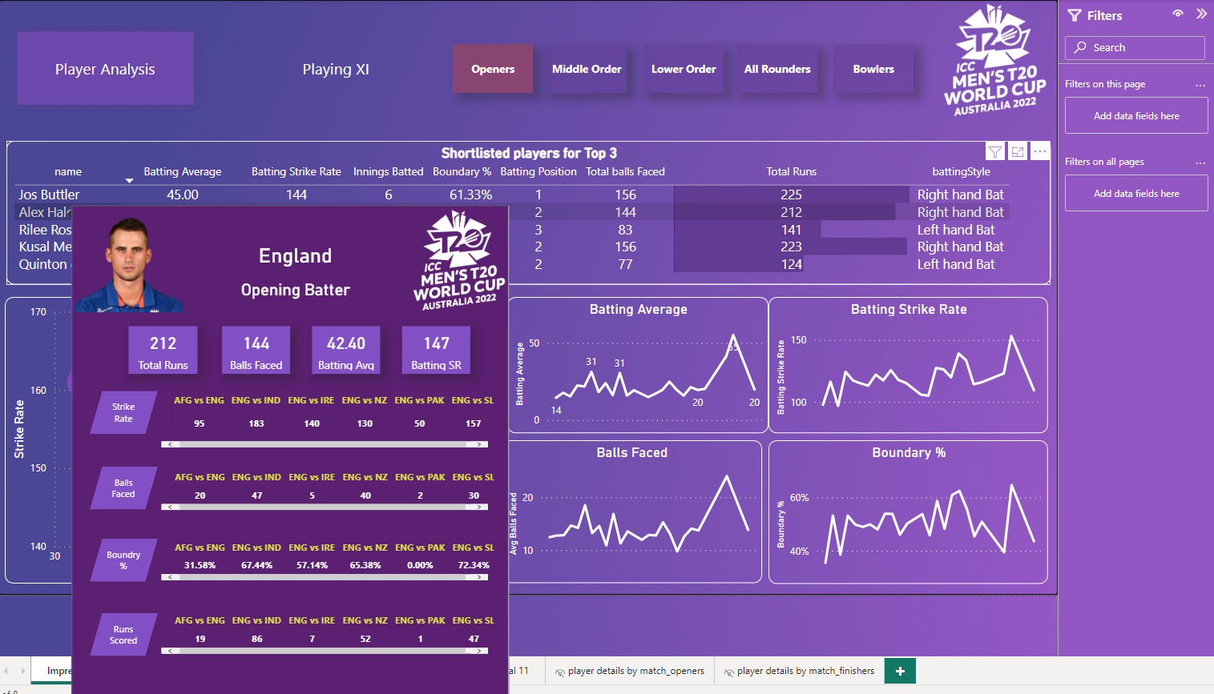
Individual Records
You can also hover any player to see there individual records. This helps in better analysis.

